Slide 1
UML
Diagrams

Slide 2
Statechart Diagrams
Statechart (or state) diagrams describe the states and responses of a class. Statechart diagrams describe the behavior of a class in response to external stimuli. These diagrams contain the following elements:
States, which represent the situations during the life of an object in which it satisfies some condition, performs some activity, or waits for some occurrence.
Transitions, which represent relationships between the different states of an object.

Slide 3
Statechart Diagram
Captures dynamic behavior (event-oriented)
Statecharts are created for objects with significant dynamic behavior
It shows the life history of a single class
Purpose
Model object lifecycle
Model reactive objects

Slide 4
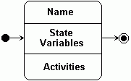
Special States
The initial state is the state entered when an object is created.
An initial state is mandatory.
Only one initial state is permitted.
The initial state is represented as a solid circle.
A final state indicates the end of life for an object.
A final state is optional.
A final state is indicated by a bull’s eye.
More than one final state may exist.
Locked
Notes:
Explain the need for start and final states.
There is exactly one initial (start) state and 0..* final (end) states.
To emphasize why an initial state is mandatory, ask the students to think about how they would read a diagram without an initial state.
Note: Refer to the statement that “Only one initial state is permitted.” This is not always true. When you have nested states, there can be an initial state within each nested state AND the one outside of them.
The initial state indicates the default starting place for the state machine or sub-state. An initial state is represented as a filled black circle.
The final state indicates the completion of the execution of the state machine or the enclosing state. A final state is represented as a filled black circle surrounded by an unfilled circle.
Initial and final states are actually pseudo-states. Neither may have the usual parts of a normal state, except for a name.

Slide 5
Events, Actions & Transitions
An event is an occurrence of a stimulus that can trigger a state transition.
A transition is a change from an originating state to a successor state as a result of some stimulus.
The successor state could possibly be the originating state.
A transition may take place in response to an event.
Transitions can be labeled with event names.
Locked
Unlocked
coin/unlock
Transition
Event Name/ action
Notes:
A Transition can be defined as:
A relationship between two states indicating that an object in the first state performs certain actions and enters a second state when a specified event occurs and specified conditions are satisfied. On such a change of state, the transition is said to “fire.” Until the transition fires, the object is said to be in the “source” state. After it fires, it is said to be in the “target” state.
You can show one or more state transitions from a state as long as each transition is unique. Transitions originating from a state can not have the same event unless there are conditions on the event.
The icon for a state transition is a line with an arrowhead pointing toward the destination state.
Label each state transition with the name of at least one event that causes the state transition. You do not have to use unique labels for state transitions because the same event can cause a transition to many different states but it is recommended that they have unique labels.
Explain transitions on a state machine.
Transitions are not bi-directional. If transitions need to run both ways between two states, you can draw two different transitions going in opposite directions.

Slide 6
Statechart Diagram
A statechart diagram shows the lifecycle of a single class.
Add student[ count < 10 ]
Add Student /
Initialization
Set count = 0
Open
do: Initialize course
entry: Register student
exit: Increment count
Cancel
Cancel
[ count = 10 ]
Canceled
do: Notify registered
students
Closed
Cancel
do: Finalize course
Notes:
For classes that exhibit significant dynamic behavior, it is often necessary to examine their states. A statechart diagram looks at the lifecycle of a single class. A state is a condition that an object in the class may be in. Look at the CourseOffering class on the slide.
Here, we have identified four states—Initialization, Open, Closed, and Canceled. There are two special states—a start state, the state an object is in when it is created and an end state, the state an object is in when it is destroyed.
There is only one start state, but there can be zero or more end states. Transitions show how to get from one state to another. A transition may have an event associated with it. There may also be an action associated with the transition. For example, if you are in the Initialization state and receive the Add student message, set the count to zero and transition to the Open state.
A transition may also have a guard condition. If you are in the Open state and the count reaches 10, you automatically transition to the Closed state. If you look at the Open state, there are two ways to enter into it. If there is something that you want to do whenever you enter a state, you can show this behavior as an entry action. Similarly, if there is something that you want to do whenever you leave a state, you can show it as an exit action.
Finally, show behavior that occurs while in a state as an activity. The activity starts when the state is entered and finishes. Or, it may be interrupted by an outgoing transition.
We will not model the statechart diagram in this course.

Slide 7
Example: Toaster
Toaster On
Toaster Off

Slide 8

Example: Toaster

Slide 9
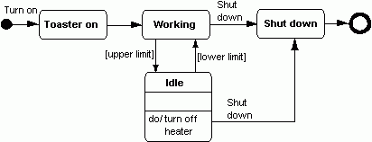
Example: Toaster

Slide 10
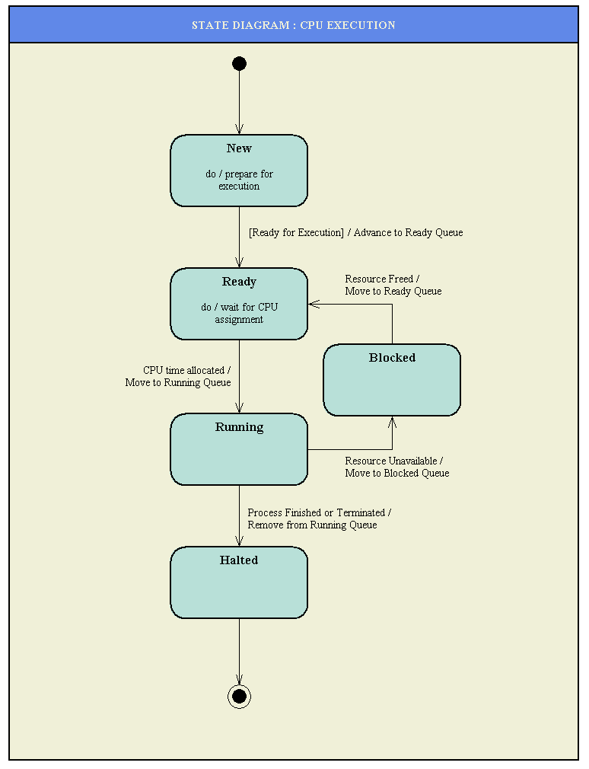
State Chart Diagram

Slide 11
State Diagrams
State is a set of values that describe an object at a certain instant.
State diagrams provide an exact view of what happens in one object when it receives successive messages.
Not every class needs to have its state diagram - only when they are very dynamic it is helpful for the understanding of all the possible states of an object and when a message would trigger each transition from one state to another.

Slide 12
State Diagrams
start
stop
Initial state A
Event name
State B
Reserved actions:
entry: a specific action performed on the entry to the state
do: an ongoing action performed while in the state
on: a specific action performed as a result of a specific event
Exit: a specific action performed on exiting the state
State name
State variables
entry:entry-action
do:activity-A
on event-A: action-B
exit: exit-action
State name

Slide 13
State Diagram Example
enter PWD
CheckPWD
do: compare PWD
OK
Instantiate
:OwnerInfo
PWD unacceptable
(repeat 2 times)
PWD unacceptable
(3rd. wrong entry)
UnacceptablePWD
do: ask to repeat

Slide 14
State Diagram Carryovers
The following items are common to state diagrams and activity diagrams:
activities
actions
transitions
initial/final states
guard conditions
Bid plan
Do construction
entry/setLock()

Slide 15
Breaking Up Flows
alternate paths:
branch
merge
parallel flows:
fork
join

Slide 16
Branching
A branch has one incoming transition and two or more outgoing transitions:
Charge credit
card
[today  7 days before show]
[today < 7 days before show]
Mail tickets
Hold in will-call

Slide 17
Merging
A merge has two or more incoming transitions and one outgoing transition:
Mail tickets
Customer picks
up tickets
Customer
sees show

Slide 18
Forking
A fork represents the splitting of a single flow of control into two or more concurrent flows of control:
Receive order
Log order
Process order

Slide 19
Joining
A join represents the synchronization of two or more flows of control into one sequential flow of control:
Receive product
Bill customer
Pay bill

Slide 20
Swimlanes
Swimlanes partition groups of activities based on, for instance, business organizations:
Customer
Billing
Receive product
Bill customer
Pay bill

Slide 21
Activity Diagrams
Activity diagrams describe the activities of a class. These diagrams are similar to statechart diagrams and use similar conventions, but activity diagrams describe the behavior of a class in response to internal processing rather than external events as in statechart diagram.
Swimlanes, which represent responsibilities of one or more objects for actions within an overall activity; that is, they divide the activity states into groups and assign these groups to objects that must perform the activities.
Action States, which represent atomic, or noninterruptible, actions of entities or steps in the execution of an algorithm.
Action flows, which represent relationships between the different action states of an entity.

Slide 22
Activity Diagrams (Cont...)
Object flows, which represent the utilization of objects by action states and the influence of action states on objects.

Slide 23
Activity Diagram
An activity diagram captures dynamic behavior (activity-oriented)
Activity diagrams may be created for use cases, classes, and/or operations
Purpose
Model workflow
Model operations

Slide 24
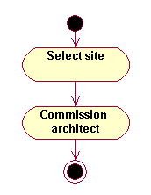
Activity
An activity represents the performance of a task within the workflow.
In the UML, an activity is represented by a lozenge (horizontal top and bottom with convex sides).
Activity
State
Notes:
An activity is similar to a state, but expresses the intent that there is no significant waiting (for events) in an activity.
In the UML, a state is represented by a rectangle with rounded corners. We’ve shown the difference between an activity and state in the slide above.

Slide 25
Start State
A start state explicitly shows the beginning of a workflow on an activity diagram.
There is only one start state.
In the UML, a start state is represented by a solid circle.
Start State

Slide 26
End State
A end state represents a final or terminal state on an activity diagram.
There can be zero or more end states on an activity diagram.
In the UML, an end state is represented by a bull’s eye.
End State

Slide 27
State Transitions
A state transition shows what activity follows after another.
In the UML, a state transition is represented by a solid line with an arrow.
State Transition
Notes:
Each diagram has its own toolbar. On an activity or statechart diagram, the solid line with an arrow represents a state transition. The same arrow can represent something different on another diagram. For example, a solid line with an arrow represents an association relationship on a use-case diagram.
You can also have a transition to self. It is similar to a state transition. However, it does not move the focus of control to another activity when an event occurs.
State transitions can be labeled with events, guard conditions, or actions using the Specification window in Rose.

Slide 28
Decisions
A decision is a point in an activity diagram where guard conditions are used to indicate different possible transitions.
In the UML, a decision is represented by a diamond.
Notes:
Guard conditions control the transition of a set of alternative transitions that follows after the activity has been completed.
You may also use the decision icon to show where the threads merge again.
Decisions and guard conditions allow you to show alternative threads in the workflow of a use case.
Guard conditions are placed on the state transition and can be added through the transition’s Specification window in Rose.

Slide 29
Synchronization Bars
A synchronization bar allows you to show concurrent threads in a workflow of a use case.
In the UML, a synchronization bar is represented by a thick horizontal or vertical line.

Slide 30
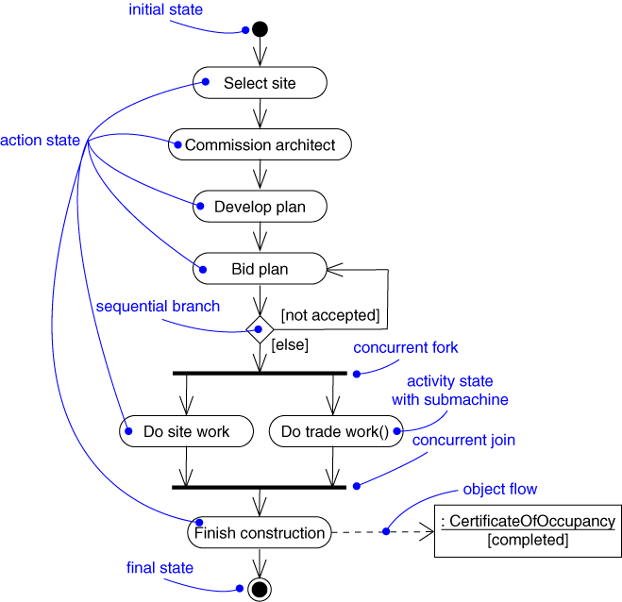
Activity Diagram

Slide 31
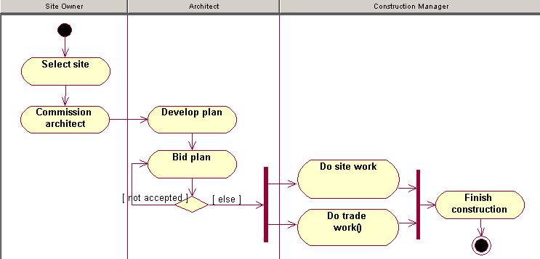
Swimlanes
A swimlane is used to partition an activity diagram to help us better understand who or what is initiating the activity.
Swimlane
Notes:
Each swimlane should represent a responsibility for part of the overall workflow, carried by a part of the organization. A swimlane may eventually be implemented by an organization unit or a set of classes in the business object model.
The relative ordering of swimlanes has no semantic significance. Each activity state is assigned to one swimlane and transitions may cross lanes.

Slide 32
What Is an Activity Diagram?
An activity diagram in the use-case model can be used to capture the activities and actions performed in a use case.
It is essentially a flow chart, showing flow of control from one activity or action to another.
Flow of Events
This use case starts when the Registrar requests that the system close registration.
1. The system checks to see if registration is in progress. If it is, then a message is displayed to the Registrar and the use case terminates. The Close Registration processing cannot be performed if registration is in progress.
2. For each course offering, the system checks if a professor has signed up to teach the course offering and at least three students have registered. If so, the system commits the course offering for each schedule that contains it.
Activity 2
Activity 1
Activity 3
Notes:
The workflow of a use case describes that which needs to be done by the system to provide the value the served actor is looking for.
It consists of a sequence of activities and actions that together produce something for the actor.
The workflow often consists of a basic flow and one or several alternative flows.
The structure of the workflow can be described graphically with the help of an activity diagram.
The goal of this section is to introduce the students to the concept of an activity diagram. You are not expected to teach them everything about this diagram at this time.
Activity diagrams can also be used to model the workings of an operation, an object, business modeling, or anything that involves modeling the sequential steps in a computational process.
This course focuses on using activity diagrams to model the flow of events in a use case.

Slide 33
What Is an Activity?
A specification of behavior expressed as a flow of execution via sequencing of subordinate units.
Subordinate units include nested activities and ultimately individual actions.
May contain boolean expression constraints when the activity is invoked or exited
Activity 2
<<Precondition>>
Activity 4
Boolean constraint
<<Postcondition>>
Activity 5
Boolean constraint
Notes:
An activity is notated as an activity diagram. An activity definition is shown as a large rounded border containing a graph of node symbols and flow arrows representing the decomposition of the activity into its constituents. Activity preconditions and postconditions use the note notation with the keywords <<Precondition>> and <<Postcondition>> respectively.
An action is a primitive activity which is the smallest computation that can be expressed. An action is an activity that does something to the state of the system or extracts information from it. An action is drawn as a rectangle with rounded corners. Action preconditions and postconditions use the note notation with the keywords <<localPrecondition>> and <<localPostcondition>> respectively.
If a high-level activity is viewed as a tree of nested activities, the leaves of the tree are actions.
Actions include arithmetic and string functions, manipulations of objects and their values, communications among objects, and similar things.
Kinds of actions include:
Accept call
Accept event
Apply function
Broadcast event
Call
Create
Destroy
Raise exception
Read
Reply
Return
Send
Time
Write

Slide 34
Example: Activity Diagram
Decision
Select Course
Activity/Action
Concurrent Threads
[ delete course ]
Delete Course
[ add course ]
Synchronization
Bar (Fork)
Guard
Condition
Check
Check
Schedule
Pre-requisites
Synchronization
Bar (Join)
[ checks completed ]
[ checks failed ]
Assign to
Resolve
Transition
Course
Conflicts
Update
Schedule
Notes:
An activity diagram may include the following elements:
Activity/Action represents the performance of a step within the workflow.
Transitions show the activity/action that follows.
Decisions evaluate conditions defined by guard conditions. These guard conditions determine which of the alternative transitions will be made and, thus, which activities are performed. You may also use the decision icon to show where the threads merge again. Decisions and guard conditions allow you to show alternative threads in the workflow of a use case.
Synchronization bars show parallel sub-flows. They allow you to show concurrent threads in the workflow of a use case.
Walk the students through the activity diagram and explain each component (decision, fork, join, and so on).

Slide 35
Activity Diagram
An activity diagram shows the flow of events within our system.
Create
curriculum
Select courses
to teach
Create
catalog
Place catalog
Mail catalog
in bookstore
to students
Open
registration
[ Registration time period expired ]
Close
registration
Notes:
In our example, you can see that someone signs on to the system and begins to create a curriculum. They select the courses to teach, which in turn begins to create our catalog. At that point, two things are done—an order is placed with the bookstore and the catalog is mailed to potential students. Registration is then opened and when the time period to register for a course ends, registration is closed. This is the basic activity for a complete course registration process.

Slide 36
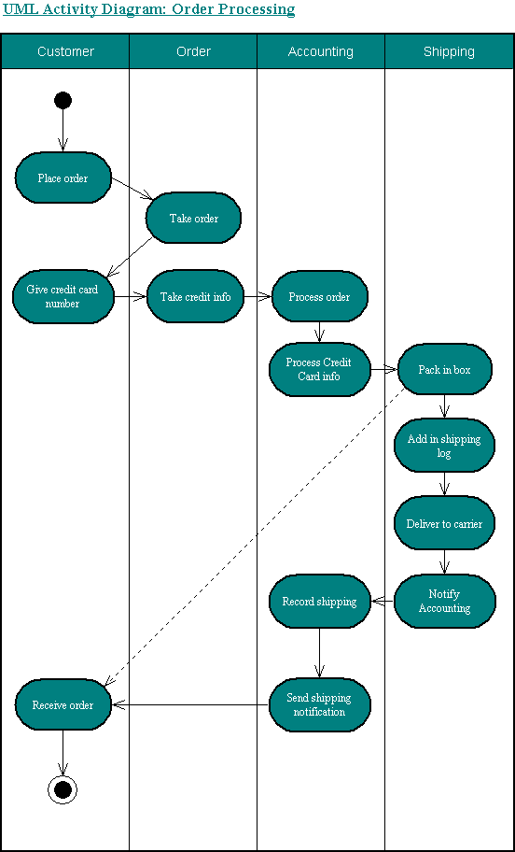
Activity Diagram

Slide 37
Activity Diagrams
Activity diagrams model the flow of activities in a procedure
States are called activities
Events are called transitions
State diagrams focus on events in one specific object as it responds to messages
Activity diagrams are used to model the entire process or use-case
The activity diagram describes the performance of a task and is not related to objects.

Slide 38
Activity Diagrams
start
stop
Initial activity
Transition
Activity-B
[Option A]
Activity-C
Decision
Activity-D
[Option B]
The bar shows that one activity leads to several that occur in parallel or in an unpredictable order.

Slide 39
Activity Diagrams Example
Check User PWD
PWD wrong 1st & 2nd time
Ask to
repeat PWD
PWD wrong
3rd time
Access declined
Get new CD data
User Info is set
User chooses
menu option
Get search criteria
......
.....

Slide 40
Component Diagrams
Component diagrams describe the organization of and dependencies among software implementation components. These diagrams contain components, which represent distributable physical units, including source code, object code, and executable code.

Slide 41
Component Diagram
Illustrates the organization and dependencies among software components
Captures the physical structure of the implementation
Built as part of architectural specification
Purpose
Model source code organization
Model an executable release
Model a physical database
Developed by architects and programmers

Slide 42
Component
A component is a physical, replaceable part of a system that conforms to, and provides the realization of, a set of interfaces.
examples:
dynamic link library (DLL)
COM+ component
Enterprise Java Bean (EJB)

Slide 43
Component Notation
Scheduler
-----------
----------
----------
----------
----------
----------
signal.cpp

Slide 44
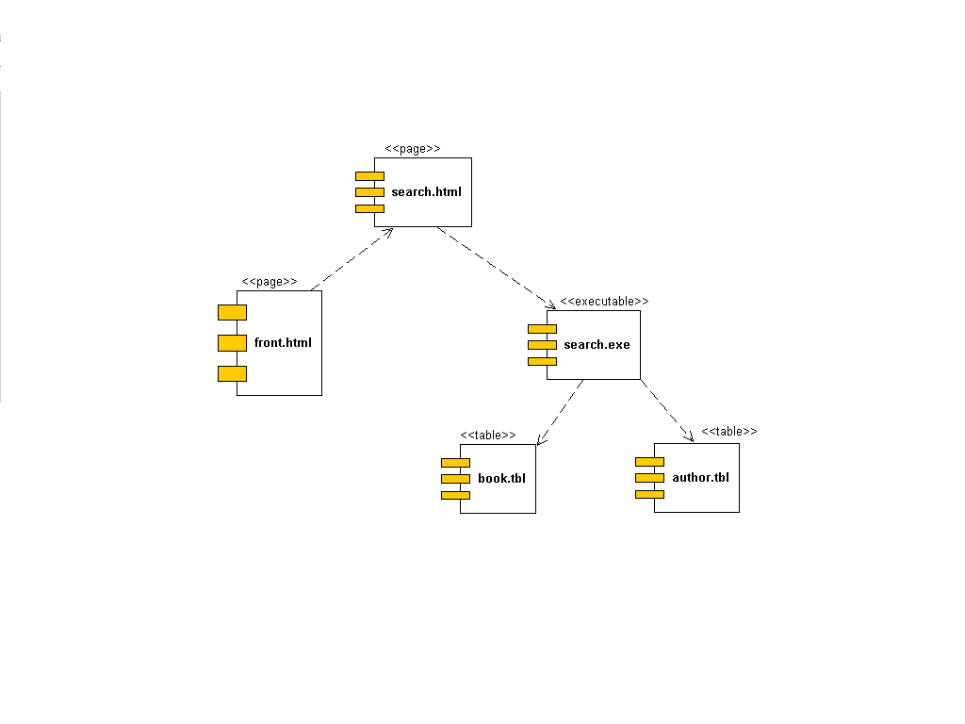

Slide 45
Node
A node is a physical element, which exists at run time, that represents some computation resource.
This resource generally has at least some memory; it often has processing capability.

Slide 46
Nodes and Components
Components are things that participate in the execution of a system; nodes are things that execute components.
A distribution unit is a set of components that have been allocated to a node as a group.

Slide 47
Component Diagrams
Component is any form of software
Component diagrams show software components and their relationships (dotted arrows)
They show physical components from a high level view to show how code-modules are distributed.
They are more often used together with deployment diagrams and not separately.
Component A
Component B

Slide 48



Component: Representation

Slide 49
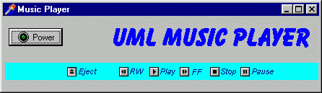
Control Identification

Slide 50
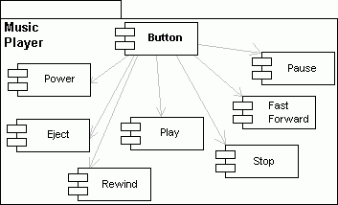
Control Realization

Slide 51
Deployment Diagrams
Deployment diagrams describe the configuration of processing resource elements and the mapping of software implementation components onto them. These diagrams contain components and nodes, which represent processing or computational resources, including computers, printers, etc.

Slide 52
About the next slide…
A deployment diagram is useful for showing how your software will be deployed on hardware. It may show how your system will integrate with existing systems in the domain.

Slide 53
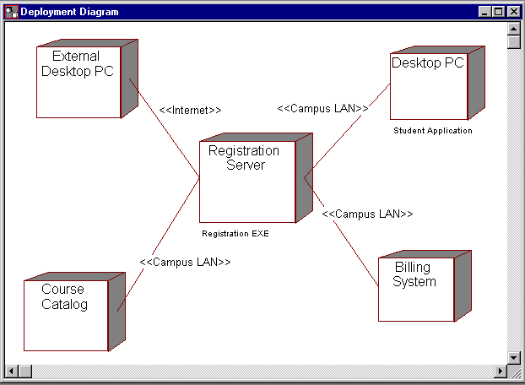

Deployment Diagram

Slide 54
Deployment Diagrams
Each node or processing element is represented by a 3D-box.
The communication/relationships are represented with solid lines
Printer
*
PC
1
Server
1
Fax
*
PC
1

Slide 55
Advantages of UML
You can model just about any type of application, running on any type and combination of hardware, operating system, programming language, and network, in UML.
Used for modeling middleware

Slide 56
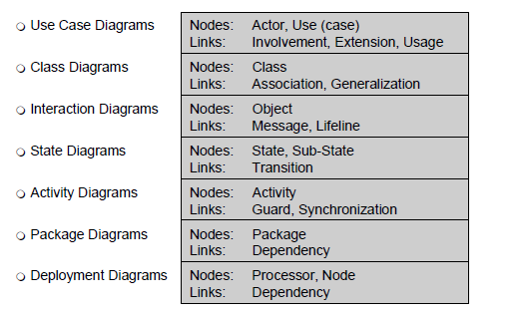
UML

Slide 57
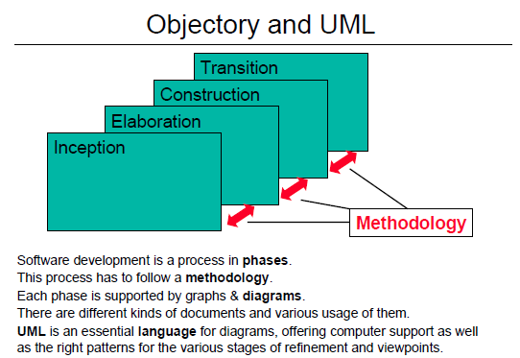
UML

Slide 58
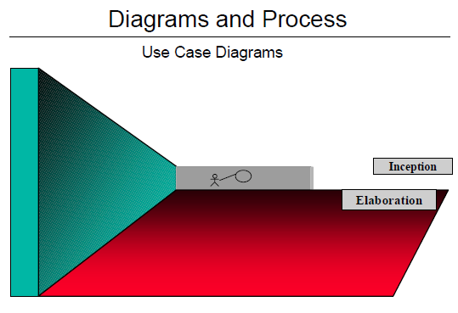
UML

Slide 59
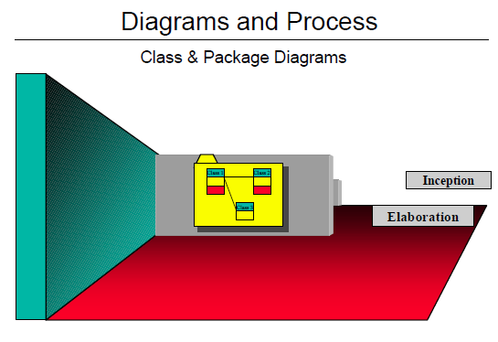
UML

Slide 60
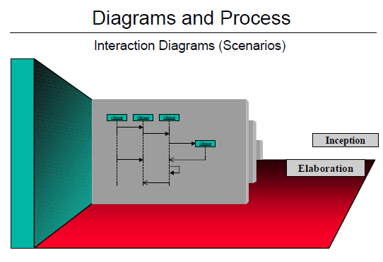
UML

Slide 61
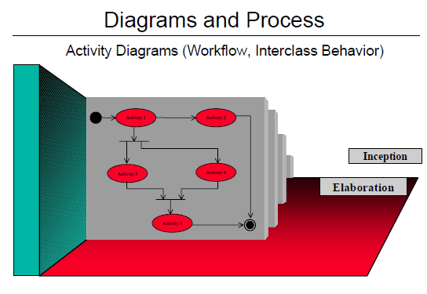
UML

Slide 62
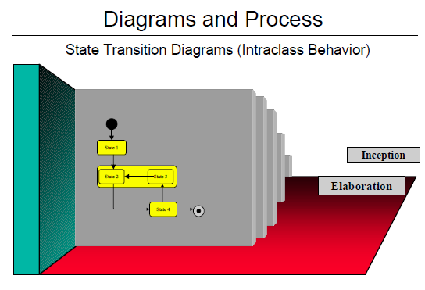
UML

Slide 63
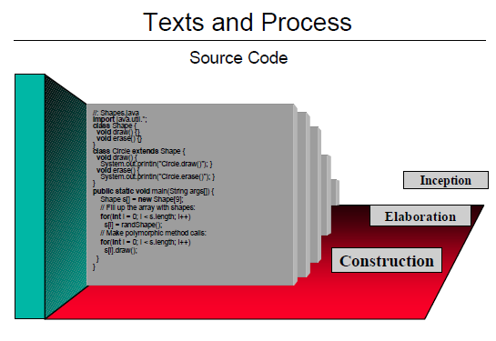
UML

Slide 64
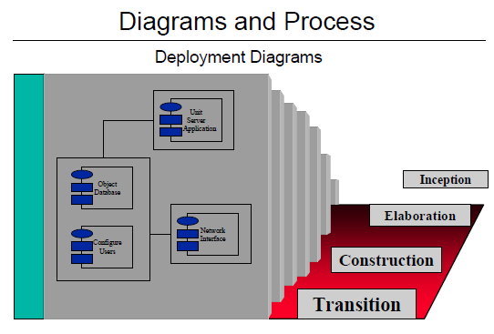
UML

Slide 65
Advantages of UML
• UML is effective for modeling large, complex software
systems
• It is simple to learn for most developers, but provides
advanced features for expert analysts, designers and architects
• It can specify systems in an implementation-independent manner. 10-20% of the constructs are used 80-90% of the time
• Structural modeling specifies a skeleton that can be refined and extended with additional structure and behavior
• Use case modeling specifies the functional requirements of system in an object-oriented manner

Slide 66
Other uses of UML
analyze existing source code and reverse-engineer it into a set of UML diagrams.
execute UML models, typically in one of two ways:
execute your model interpretively in a way that lets you confirm that it really does what you want, but without the scalability and speed that you'll need in your deployed application.
work only within a restricted application domain generate program language code from UML, producing most of a bug-free, deployable application that runs quickly if the code generator incorporates best-practice scalable patterns for, A number of tools on the market generate Test and Verification Suites from UML models.

